Slide 1
i-Transform
Scale Higher

Slide 2
Agenda
Java Full Stack Project Guidelines
Expected Front End Modules Implementation
Expected Middleware Modules Implementation
Expected Back End Implementation
Case Study Options
Project Evaluation Criteria
Project Video Demo
One Page Resume
Project implementation support process

Slide 3


i-Transfrom Project Guidelines

Slide 4






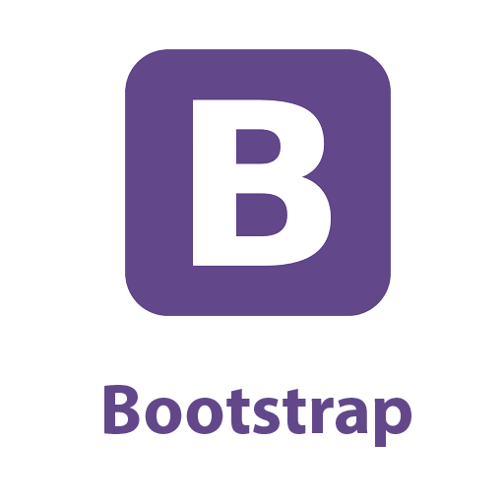






Java Full Stack Project Guidelines
Source Code Management using GIT
Mandatory Technologies for the Project
Front End
Middleware
Back End

Slide 5
Expected Front End Modules Implementation
HTML 5
Implementing new features of HTML 5 example (Semantic elements & new form elements attributes)
CSS 3 & Bootstrap
Material Design Template
Reusable templates
Optimized UI Designed
Angular 11 and above (Preferably 13)
Components
Services
Modules
Routing
Forms & Validation
Testing using Jasmin & Karma
React
Components
Hooks
Event Handling
Redux
Reducers
Testing using Jasmin & Karma

Slide 6
Expected Middle Wear Modules Implementation
Core Java
OOPS concept implementation
Collection Framework
Exception Handling
Logging
Junit & Mockito for Testing
Code coverage tool EclEmma
Static code analysis using PMD or Checkstyle
Java 8 features
Lambda Expression
Stream API
Date & Time API (Base on the Project requirement)
Spring
Spring Core
DI & IOC
Autowire
Spring REST
REST controllers
Implementation of GET, POST, PUT & DELETE
Bean Validation & Exception Handling
Testing Services, Controller & Repository layer
Spring Security
Authentication & Authorization
Spring Data
Implement DAO layer using spring Data repositories
Microservices using Spring Boot
Sync &Async Communication
Messaging Services
Swagger API Documents
Spring Cloud
Service discovery using Eureka
Centralize configuration using config server
Load balancer
Circuit breaker using Hystrix
Zuul API Gateway
Testing Microservices

Slide 7
Expected Back End Implementation
You need to use MongoDB as part of your case study implementation.
MongoDB Atlas cloud is recommended for better management of data.
You can use additionally MySQL database incase you are planning to implement polyglot architecture

Slide 8
Case Study Options
On Demand Car Wash System
Online Railway Reservation System
Online Hotel Management System
Flight Booking System
Deals And Coupons Finder App
E-shopping Zone E Commerce website

Slide 9
Project Evaluation Criteria

Slide 10
Project Evaluation Criteria
Working UI : While evaluating project working UI is must, points will be given based on working features, error free validation & accurate result based on various inputs.
Backend Solution : For the backend all the necessary scripts, queries and solution need to be ready for evaluation.
Ability to explain the code : It is important to know your code implementation, functionality and working flow. Candidate should able to explain the code and working flow of the project.
Proper Project Directory Structure : Project Directory Structure should be as per industry standards for better readability & maintenance.
Unit Tests for each layer : In the evaluation testing is being consider important part of every development. Each layer (Front End, Middle End & Back End) should take care good unit test cases along with maximum code coverage
Unique Features : In the evaluation we will look for Unique features what you bring to your project.
Understanding of Libraries/Frameworks : To achieve faster development we do use various libraries or frameworks. Where to use what and how-to bring effectiveness is important in the development. It is expected from the candidate to know those details while explaining their code.
Best Practices : Candidate must follow industry standards Naming Conventions, Code indention, Comments, Exception Handling, Logging & Unit and Integration Testing for the effectiveness and readability of code. (Use code analysis tool)

Slide 11
Project Video Demo
Incase video didn’t play click here

Slide 12
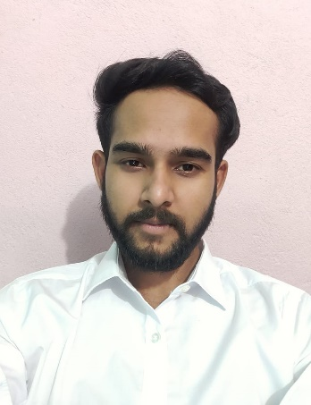



Raubins Raj
Analyst/Software Engineer
Bachelor of Engineering
Computer Science : 2016 - 2020
Skills Java 8 /J2EE
Spring Boot
Spring MVC
JPA CRUD
Bootstrap
MERN Stack
ReactJS
NodeJS
ExpressJS
MongoDB
Database
SQL database – Oracle, MySQL
No SQL database – MongoDB
Web Technologies
HTML5
CSS3
Javascript
AddOns
Github
Maven
Postman
Additional Details
Leadership
Excellent Communication Skills
Team management
Bangalore
xxxxxxxxxxx@capgemini.com
+91 xxxxxxxxxxxx
A4
Software Engineer who is Strong in design and integration with intuitive problem-solving skills. Passionate about implementing and launching new projects.
Ready to learn new technologies and implement them to further improve my knowledge.
Eager to work in a team of dedicated people and serve a key role in the enhancement and development of the project.
Has working knowledge on ReactJS(Hooks, redux)and Java Microservice Development using Spring framework on an intermediate level.
Also Implemented Nodejs and ExpressJs in case study and upskilling day by day.
E-Commerce Shopping Cart Application
Completed end to end case study of Shopping Cart Application along with JWT authentication, Swagger and payment testing using Braintree in MERN Stack. Material-UI and React Bootstrap used for user interface.
Online Bus Booking Application
Developed Online Bus Booking Application Using spring microservices and AngularJs with MYSQl as database in agile methodology of software development model.
HTML CSS JAVASCRIPT for web developers at Coursera
Completed this course with 98.6% and Designed responsive Restaurant website using HTML5 CSS3 Bootstrap and Javascript
Completed ”Build your first React website“ course at Coursera
Check out my work on GitHub & Video Profile

Slide 13
Project Implementation Support Process
In Daily call with mentors, You will present your case study to get inputs to improve your case study
Week’s best demo from each batch will get chance to present in front of Architect Group every week
Final Presentation with Video demo

